Slide 1
Image and Video Analytics
Image Classification Using
KNN Algorithm

Slide 2
Machine Learning
Definition
It is the study of algorithms that improves automatically through experience. It is the subset of AI.
Types of ML.
1. Supervised
2. Unsupervised
3. Reinforcement

Slide 3
SUPERVISED AND UNSUPERVISED
Supervised Machine Learning is labeled data, where as unsupervised is unlabeled data.
Supervised machine learning Categorized into:
Classification
Regression.
Classification → category type like yes or no (Binary classification)
Regression → real value or continuous data like weights (Multi-class classification).

Slide 4
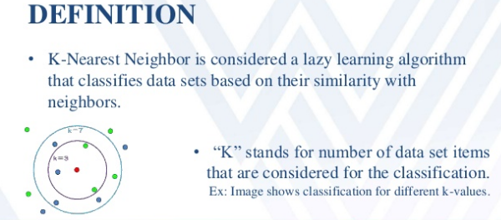

Slide 5
KNN ALGORITHM
For a given instance T, get the top k dataset instances that are “nearest” to T
Select a reasonable distance measure
Inspect the category of these k instances, choose the category C that represent the most instances
Conclude that T belongs to category C

Slide 6

Distance Measures
Euclidean distance
D(p,q) =$\sqrt{{(p1−q1)}^{2}+{(p2−q2)}^{2}}$,
Manhattan Distance
|x₁ - x₂| + |y₁ - y₂|

Slide 7
KNN ALGORITHM
How to select appropriate K?
In real-world problems, the dataset is separated into three parts, namely, training, validation, and test data.
In KNN, the training data points get stored, and no learning is performed.
Validation data is to check the model performance, and the test data is used for prediction.
To select optimal K, plot the error of model (error = 1 — accuracy) on training as well as on the validation dataset.
The best K is where the validation error is lowest, and both training and validation errors are close to each other.

Slide 8
1-Nearest Neighbor
One of the simplest of all machine learning classifiers
Simple idea: label a new point the same as the closest known point
Label it red.

Slide 9
k – Nearest Neighbor
Generalizes 1-NN to smooth away noise in the labels
A new point is now assigned the most frequent label of its k nearest neighbors
Label it red, when k = 3
Label it blue, when k = 7

Slide 10
Selecting the Number of Neighbors
Increase k:
Makes KNN less sensitive to noise
Decrease k:
Allows capturing finer structure of space
➔Pick k not too large, but not too small (depends on data)

Slide 11
LIMITATIONS OF KNN
Time complexity and space complexity is enormous, which is a major disadvantage of KNN.
Time complexity refers to the time model takes to evaluate the class of the query point.
Space complexity refers to the total memory used by the algorithm.

Slide 12
Drawbacks
The testing phase of K-nearest neighbor classification is slower and costlier in terms of time and memory.
It requires large memory for storing the entire training dataset for prediction.
KNN requires scaling of data because KNN uses the Euclidean distance between two data points to find nearest neighbors. Euclidean distance is sensitive to magnitudes.
The features with high magnitudes will weight more than features with low magnitudes. KNN also not suitable for large dimensional data.

Slide 13
KNN ALGORITHM IMPLEMENTATION
Implement the knn in scikit library in python.
Before using knn algorithm, we’ve to load the values(in image we’ve pixel values).
Then split the data and train the model by train_test_splilt(sklearn.cross_validation)
from sklearn.neighbors import KNeighborsClassifier by using this command line we can import knn.

Slide 14
KNN Algorithm
After implementing the knn, we’ve to find accuracy (by importing metrics).
Plot the data which you found.
Here I prepared a example in google colab
link (https://colab.research.google.com/drive/1QECdNh-2TD0o7B9CfGXMlYiHvWlmcyGe#scrollTo=QojJS5X3k62P)

Slide 15
KNN APPLICATIONS
Real time world applications
KNN can be used for Recommendation Systems. Although in the real world, more sophisticated algorithms are used for the recommendation system.
Many companies make a personalized recommendation for its consumers, such as Netflix, Amazon, YouTube, and many more.

Slide 16
KNN APPLICATIONS
KNN can search for semantically similar documents. Each document is considered as a vector. If documents are close to each other, that means the documents contain identical topics.
KNN can be effectively used in detecting outliers. One such example is Credit Card fraud detection.

Slide 17
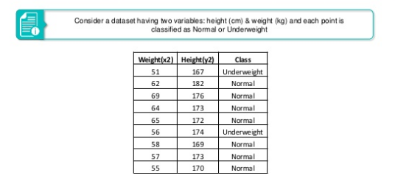

Slide 18
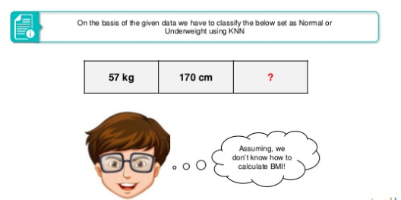

Slide 19
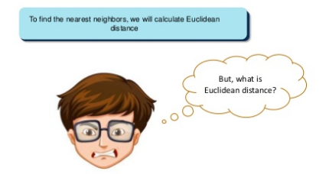

Slide 20
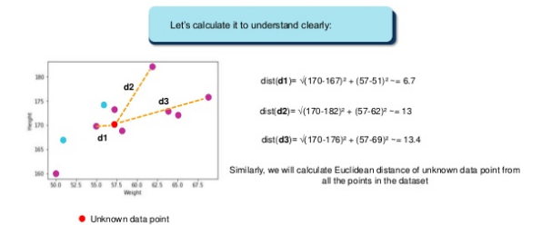

Slide 21
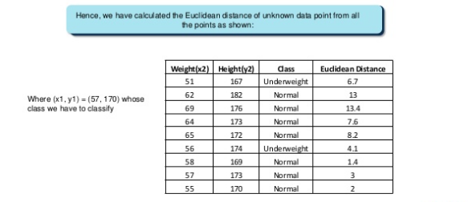

Slide 22
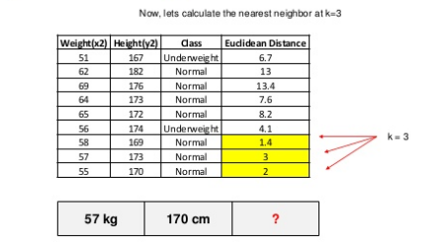

Slide 23
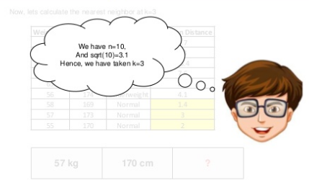

Slide 24
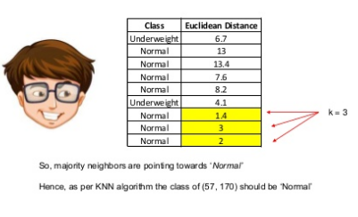

Slide 25
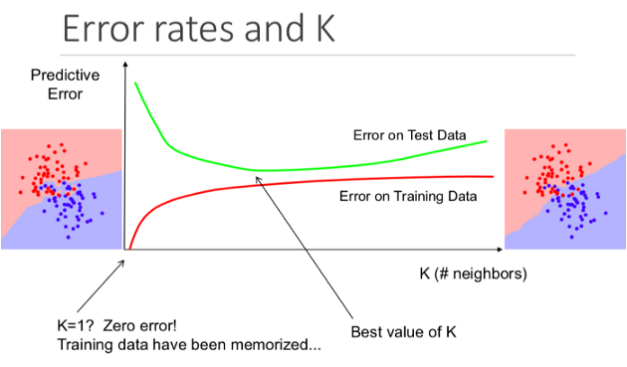

Slide 26
THANK YOU

